Slide 1
Video Games
Sales
Team members: Darrus (U2223371E), Charmain (U2223590D), Shivani (U2222698C)
Notes:
Good morning, i am shivani and together with mt group mates charmain and darrus, we will be presenting more about our mini project. Before we start, let me a overview of the presentation:

Slide 2
Overview
Problem
Formulation
Data Preparation & Cleaning
Data Processing
Machine Learning
Exploratory Analysis
Notes:
Problem Formulation (check point 1)
In this section, we gave an overview on the chosen problem with a brief explanation on how the analysis of the dataset would give valuable insights.
Data Preparation and Cleaning (check point 2)
In this section, a summary of the dataset used will be given. It will also provide a detailed description on how the data was prepared for data processing.
Data Processing
In this section, we outline the guiding questions we used to process the data and the results we got.
Chosen Machine Learning Model (check point 3)
In this section, we discuss the Machine learning models that were considered and detailed breakdown of the chosen model.
Exploratory Analysis & Conclusion (check point 4&5)
In this section, we present our results and the conclusion derived from the analysis.

Slide 3
01.
PROBLEM
FORMULATION

Slide 4
Problem Formulation
Dataset 1:
Video Game Sales with Ratings | Kaggle
Includes information on video games released between 1980 and 2017, collected from a variety of sources, notably VGChartz and Metacritic.
Dataset 2:
Large Video Game Companies | Kaggle
includes information on video game companies, such as their names, headquarter locations, founding dates, and revenue. It also includes the number of employees and the website URL for each company. The data was collected from public sources such as Crunchbase and the companies' official websites.
Objective
To analyze the video game sales dataset and gain insights into the factors that contribute to the success of video games.

Slide 5
Problem Formulation
Significance:
Develop important data analysis skills
Future of gaming looks bright with emergence of new technologies and increased prevalence of mobile gaming
Gain deeper understanding of the gaming industry
If pursuing a career in gaming industry
Aid in designing, developing, and marketing video games that have a higher chance of success in the market.
Aid game developers/publishers make informed decisions about:
Types of games to create
Platforms and regions to focus marketing efforts on
Notes:
Analyzing the video game sales dataset provides several insights into the factors that contribute to the success of video games. As computer science students, understanding these factors can help us in designing, developing, and marketing video games that have a higher chance of success in the market. Additionally, analyzing the video game sales dataset helps us to gain a deeper understanding of the gaming industry as a whole, which can inform our career choices in the future. By studying this dataset, we can also develop important data analysis skills, which are increasingly valuable in the field of computer science. Overall, analyzing the video game sales dataset is a valuable exercise for computer science students, as it provides a real-world application for the skills and knowledge that we acquire throughout our studies.

Slide 6

02.
Data Preparation & Cleaning

Slide 7
Data Preparation & Cleaning
Video Game Sales w Rating
Large Video Game Companies
gamesAndCompanies_df
Some of the key variables within the dataset are :
Video Game Sales w Rating
Name: Name of game
Platform: Platform of the games release (i.e. PC,PS4, etc.)
Year_of_Release: Year of the game's release
Genre: Genre of the game
Publisher: Publisher of the game
Critic_score and count - Aggregate score compiled by Metacritic staff and number of critics
User_score and count - Score by Metacritic's subscribers and number of users
Developer - Party responsible for creating the game
Rating - The ESRB ratings
Large Video Game Companies
Market Cap
Revenue
Number of Employees
Earnings
Operating Margin
P/E Ratio
Country
Notes:
Before we dive into our analysis, these are the variables that we are going to clean in each dataset before merging to ensure that our dataset is accurate and provides valuable insights without any inaccuracies or biases,

Slide 8
Data Preparation & Cleaning
Name
Genre
Year_Of_Release
Critic_Score
User_Score
NA Values
Dropped
1
Critic_count
User_Count
2
blank values
Replaced w/ median
Missing values
Dropped
Float -> Integer
3
Year_Of_Release
Notes:
we performed a variety of data cleaning techniques, such as dropping insignificant columns, formatting the data into the correct data types

Slide 9
Data Preparation & Cleaning
4
User_Score
“tbd” & blank values
Replaced w/ median
Critic_Score
Rating
“NaN” values
Replaced w/ “Unknown”
"K-A" value
Replaced w/ “E”
5
“RP” value
Replaced w/ “E10+”
6
Publisher
Developer
“NaN” values
Replaced w/ “Unknown”
Notes:
grouping the data together

Slide 10
Data Preparation & Cleaning
Country
Dropped Column
7
employeeCount
earnings
OperatingMargin
PERation
Revenue
8
null values
Replaced w/ mean
Notes:
and replacing missing values with median or mean values as required.

Slide 11
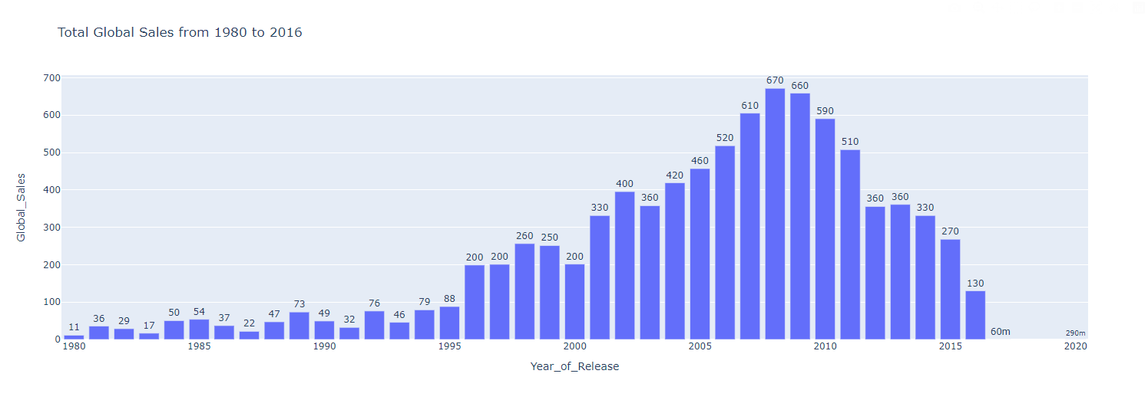
Data Preparation & Cleaning
Outliers:
Dropped
Notes:
and as outliers can have a significant influence on the data analysis outcome, we located outliers within the dataset which are games that were launched prior to 1996 and omitted them to ensure it does not skew the data and appropriately reflected the data's trends and patterns

Slide 12
Data Preparation & Cleaning
Merging:
Name
Renamed column to
“Publisher”
Large Video Game Companies
Video Game Sales w Rating (Cleaned)
Large Video Game Companies (Cleaned)
gamesAndCompanies_df
Notes:
After cleansing the dataset and omitting the outliers, we proceed to merge the 2 cleaned datasets together
We then proceed to process the data with the newly merged dataset

Slide 13
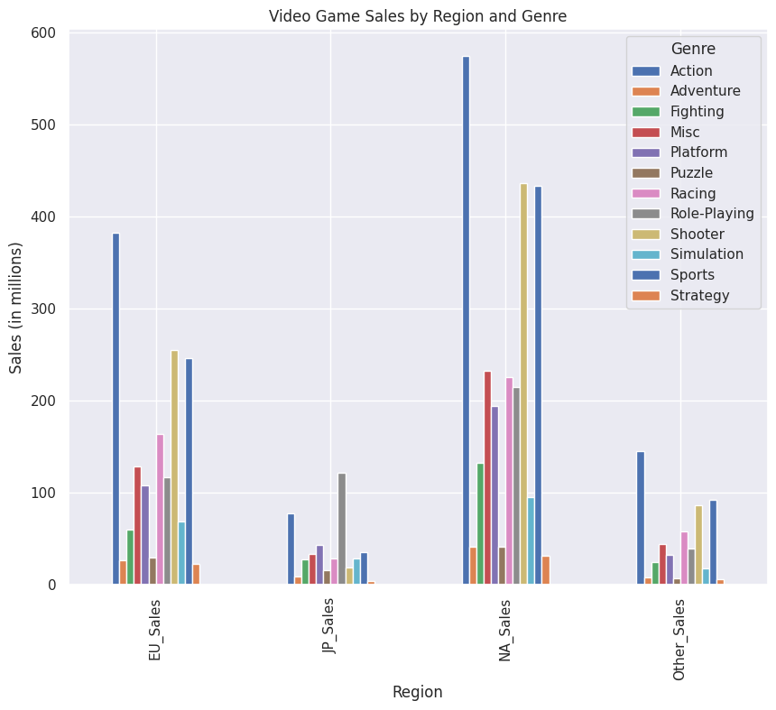
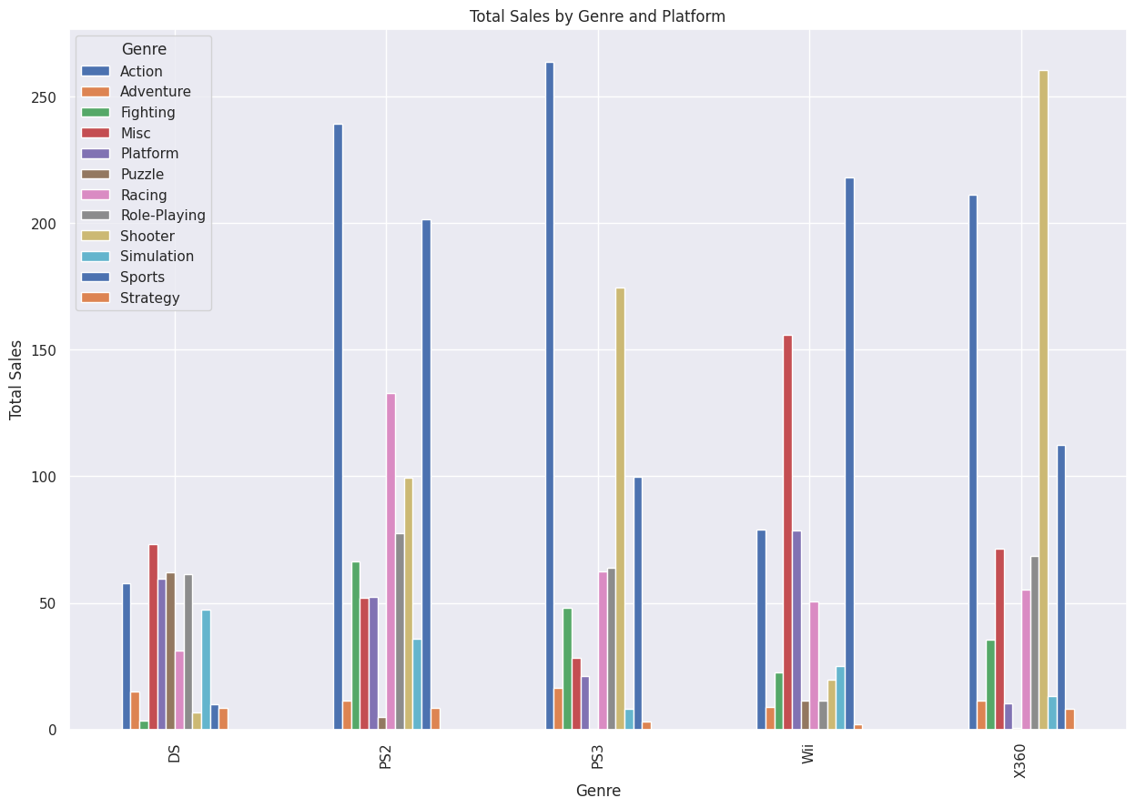
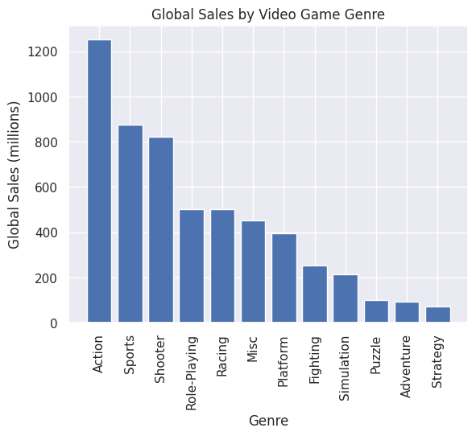
Data Processing
Q1: Which video game genres are the most successful in terms of sales, and how does this differ by platform and region?
Insights: According to the 3 figures above, Action is the most successful video game genre in terms of global sales, followed by Sports and Shooter. The success of these genres varies depending on platform and region, with Action and Sports games being successful globally while Role-Playing games being successful primarily in Japan.
Notes:
For data processing, we formulated these guiding questions
Firstly,“which video game genres are the most successful in terms of sales and how this differs by platform and region”.
Our analysis revealed that Action is the most successful video game genre in terms of global sales, followed by Sports and Shooter. The success of these genres varies depending on platform and region, with Action and Sports games being successful globally while Role-Playing games being successful primarily in Japan. And this information is critical in understanding the video game market.

Slide 14
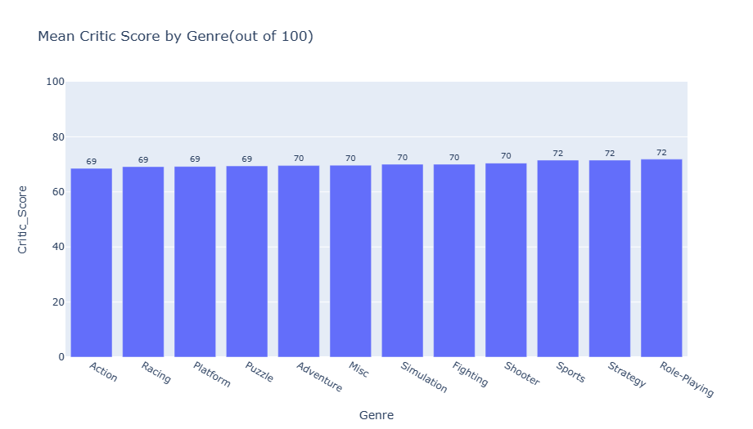
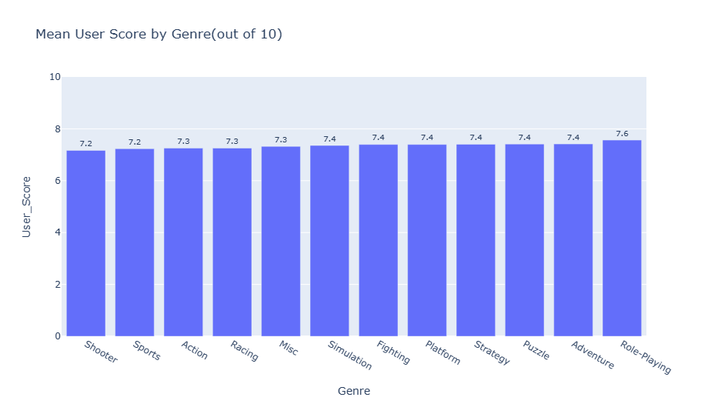
Data Processing
Q2:What influence do user reviews and critic score have on the sales success of a video game?
Top genres with highest mean critic score is:
Role playing
Strategy
Sports
Shooter
Top genres with highest mean user score is:
Role playing
Adventure
Puzzle
Strategy
5. Fighting
5. Platform
6. Simulation
6. Fighting
7. Adventure
7. Simulation
8. Miscellaneous
Notes:
Moving on to the 2nd guiding qn which is What influence do user reviews and critic score have on the sales success of a video game?
To answer this qn we first found the mean critic score and mean user score by genre.
the top genres with highest mean user score is:
Role playing (with user score of 7.6)
With the remaining tied at user score of 7.4:
Adventure
Puzzle
Strategy
Simulation
Platform
Fighting
and top genres with highest mean critic score is: The first three tied at the critic score of 72:
Role playing
Strategy
Sports
The remaining 5 tied at the critic score of 70:
Shooter
Fighting
Simulation
Fighter
Miscellaneous

Slide 15
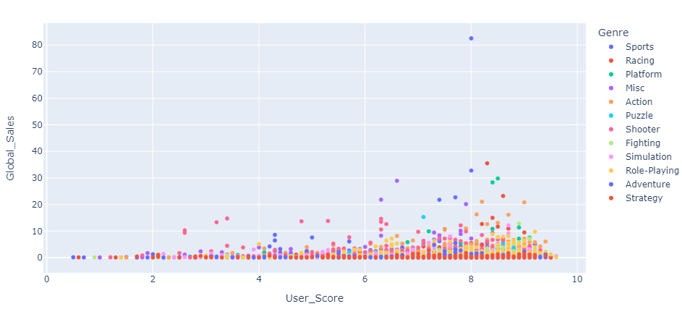
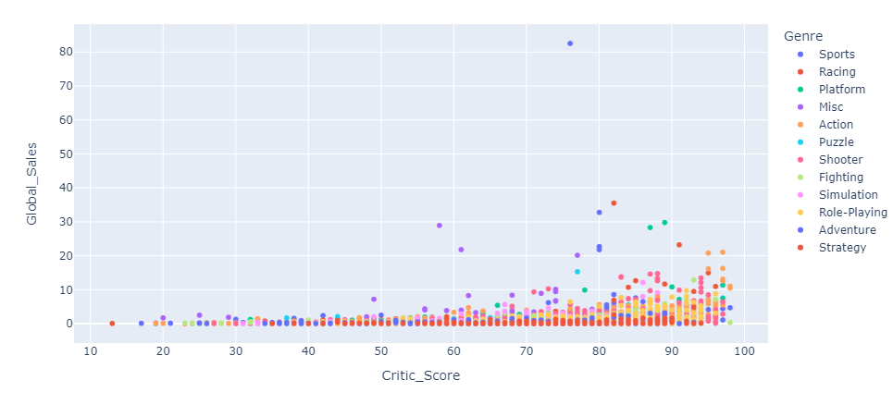
Data Processing
Q2:What influence do user reviews and critic score have on the sales success of a video game?
Effect on global sales due to user score for each genre
Effect on global sales due to critic score for each genre
Notes:
Then to get a general view to see how the user score and critic score affects global sales fro each genre we plotted scatterplot for each.

Slide 16
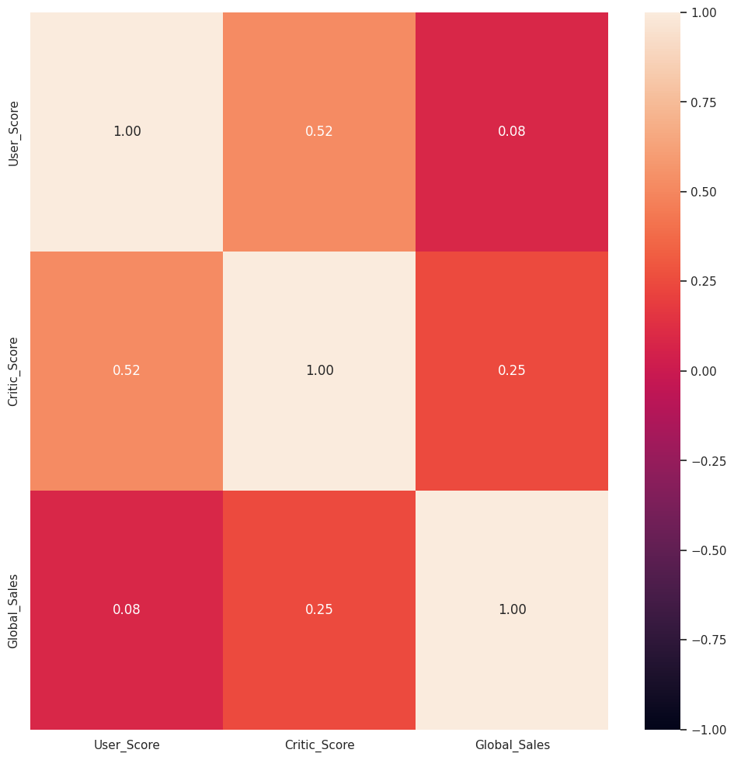
Data Processing
Q2:What influence do user reviews and critic score have on the sales success of a video game?
Comparing the two variables,according to the heatmap, critic score has a larger impact on the global sales compared to user score. The relatively low correlation score shows that there are other variables in play that affect sales success of genre.
Notes:
We then proceeded to plot a heatmap.

Slide 17
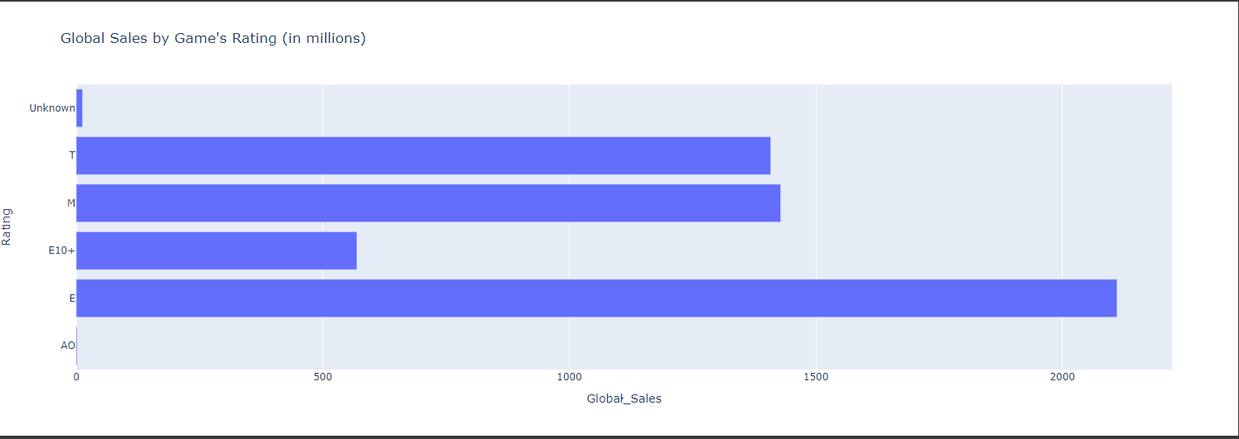
Data Processing
Q3.1: How do factors like game rating influence a video game's sales success?
T → Toddlers, M → Mature, E10+ → Everyone 10 +, E→ Everyone, AO → Adults Only
Notes:
So .. How do factors like game rating influence a video game's sales success?
This graph shows us that the sales of a video game is more successful when it has a game rating of E for everyone.

Slide 18
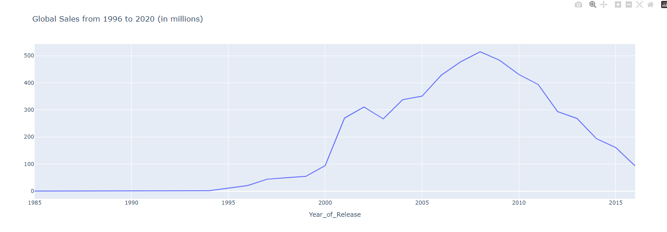
Data Processing
Q3.2: How do factors like release year influence a video game's sales success?
Year 2008 has the highest Global Sales of video games at 514 million
Notes:
Next, How do factors like release year influence a video game's sales success?
This graph shows us that in the year 2008 is the highest in terms of video game sales while in years like 1995 experienced one of the lowest video game sales.

Slide 19
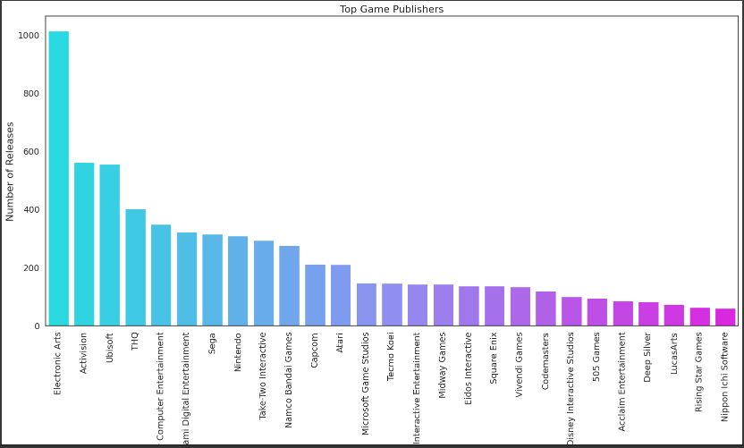

Data Processing
Q3.3: How do factors like Publisher influence a video game's sales success?
Electronic Arts has the highest number of game releases
Notes:
And next we will look at How do Publishers influence a video game's sales success?
From this graph we can tell that Electronic Arts has the highest number of game releases at around 1000 games released to this day.

Slide 20
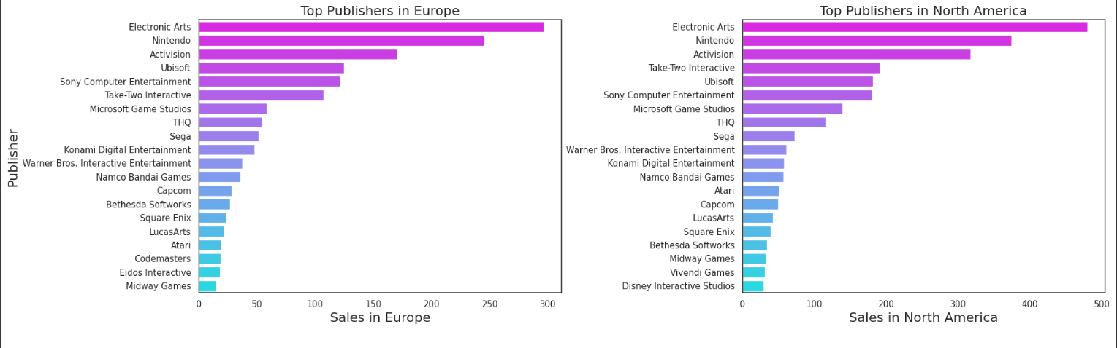
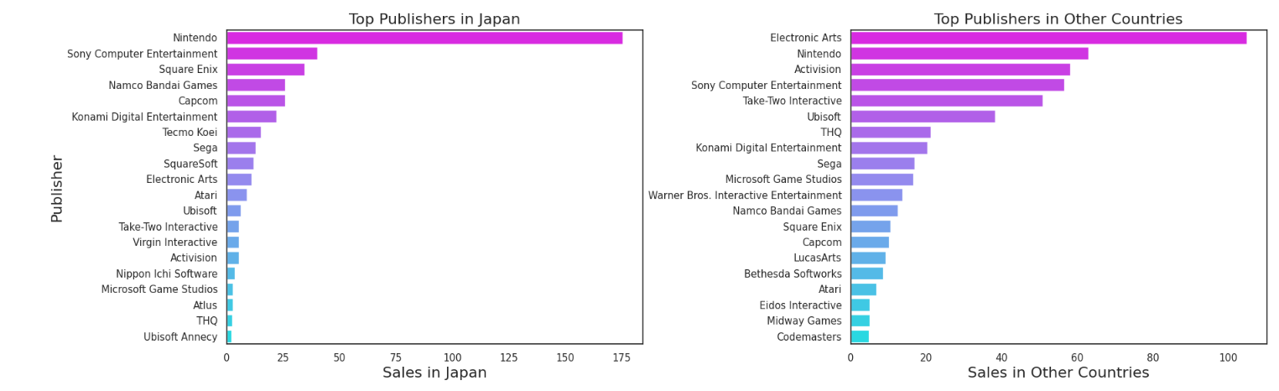
Data Processing
Q3.3: How do factors like Publisher influence a video game's sales success?
Electronic Art tops the charts for Sales in Europe, North America and Other countries while Nintendo tops the charts for Sales in Japan
Notes:
These next few graphs show us that Electronic Art tops the charts for the most video games sales in multiple regions like the US , Europe and other countries but Nintendo topped the charts for Japan which makes sense as Nintendo is a Japanese company.

Slide 21
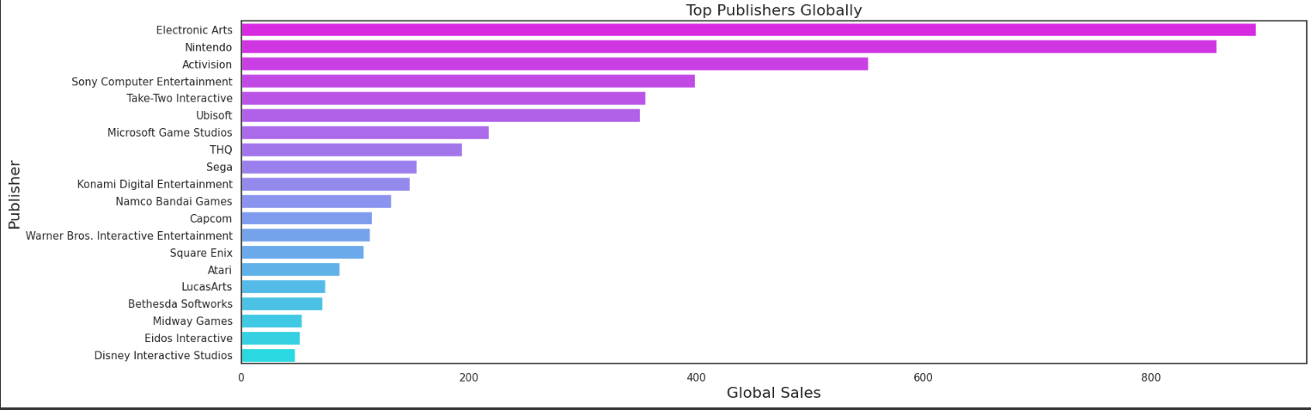
Data Processing
Q3.3: How do factors like Publisher influence a video game's sales success?
Electronic Arts and Nintendo are consistently the top few publishers of the different regions/globally
Notes:
This last graph here shows the video games sales globally and we can conclude that Publisher of a video games sales do have an impact on a video game’s sales success.

Slide 22
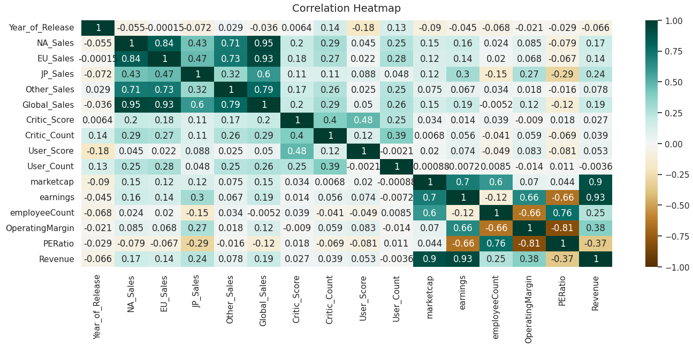
Data Processing
Q4: Which attribute has the most influence on video game sales?
Variables that has the most influence on video game sales
Critic_Count
User_Count
Critic_Score
Earnings
Revenue
Marketcap
Notes:
To answer this question on Which attribute has the most influence on video game sales?
We have come up with a correlation table of all the variables and from this correlation table we can conclude that these 6 variables are the top variables that has the most influence on video game sales.

Slide 23
03.
Machine
Learning
Notes:
I will move onto Machine Learning,

Slide 24
The Variables used for ML
Predictors
marketcap
Critic_Score
Critic_Count
User_Count
Response
Global_Sales
Earnings, Revenue are not used for predictors as Revenue and earnings similar to Sales
Notes:
So the variables that our group has decided on is marketcap , Critic_Score , Critic_Count, User_Count for the predictors and Global Sales for the response, as Global_Sales is a numeric value, we will be using Regression models for our machine learning

Slide 25
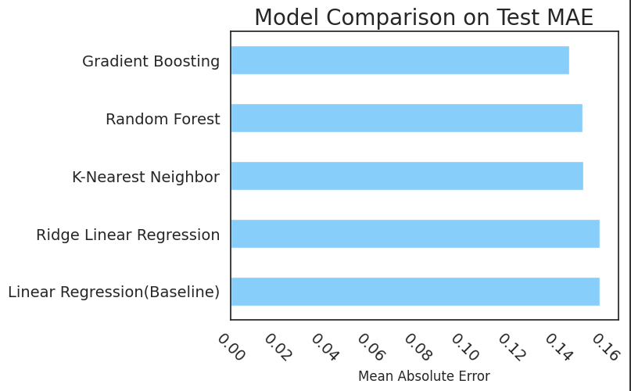
Comparison of Models
Comparing between these models:
K Nearest Neighbor
Random Forest
Gradient Boosting
Ridge Linear Regression
Linear Regression (Baseline)
Performance metrics used
Mean Absolute Error
Notes:
The performance metrics that we will be focusing on is Mean Absolute Error, we will not be using MSE as we have unskewed the variables hence it would make more sense to use Mean Absolute Error instead.
The baseline model we will be using is Linear Regression as it is the most basic and common model . After fitting and predicting we can see from this graph that Gradient Boosting is the most optimal model to use and hence we will be using Gradient Boosting for our model.

Slide 26
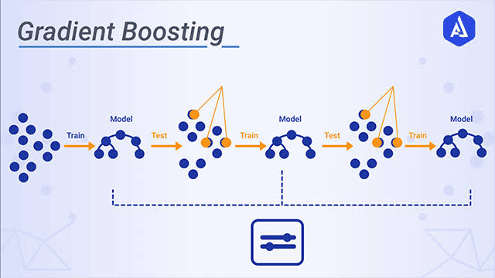
Choice of Model
Gradient Boosting
Gradient Boosting model did the best in terms of MAE
What is Gradient Boosting
Three Elements
A loss function to be optimized.
A weak learner to make predictions.
An additive model to add weak learners to minimize the loss function.
Notes:
We have chosen gradient Boosting as it did the best in MAE but we have also chosen this model as it is one of the best models in terms of accuracy and flexibility in the hyperparameters.
So What is Gradient Boosting? Gradient boosting involves three element
A loss function to be optimised, A weak learner which is a Decision Tree to make predictions
And Lastly .. Trees are added one at a time, and existing trees in the model are not changed. A gradient descent procedure is used to minimize the loss when adding trees.

Slide 27
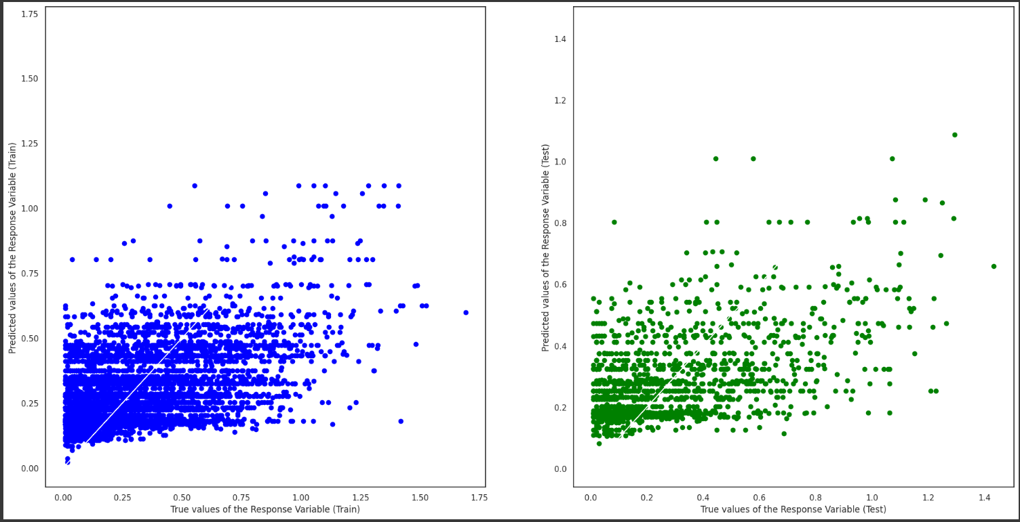
Plotting Regression Line
Notes:
This is the regression line graph after predicting and fitting the model.

Slide 28
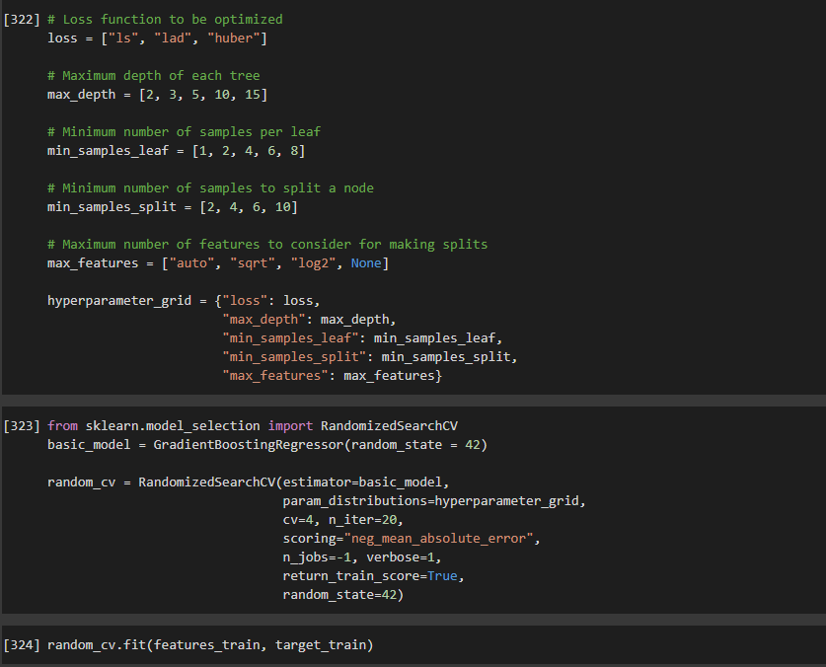
Choosing the best hyperparameters
To choose the best hyperparameters for Gradient Boosting Model we will use RandomisedSearchCV for the following parameters
Loss
Max_Depth
Min_samples_leaf
Min_samples_split
Max_features
Notes:
For hyperparameter tuning we are using RandomisedSearchCV to tune these parameters and

Slide 29
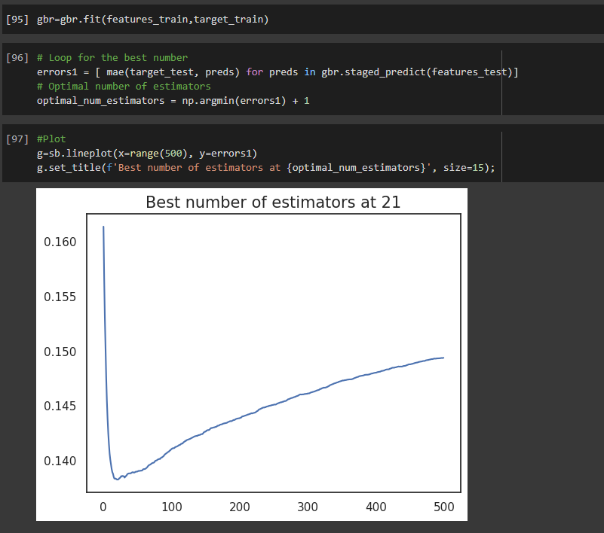
Choosing the best hyperparameters
For n_estimators we will be using an iteration method with staged_predict which iterates from 0 to the n_estimator you provide.
The best number of estimators is at 21 and 0.1 Learning Rate
Notes:
…For n_estimators we will be using an iteration method in Gradient Boosting which is using staged_predict to iterate from 0 to the number of estimators you provide.

Slide 30
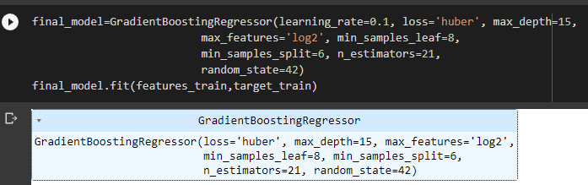
Conclusion of best hyperparameters
These are the best hyperparameters to use for Gradient Boosting that yields the best accuracy
Notes:
These are the best hyperparameters after tuning.

Slide 31


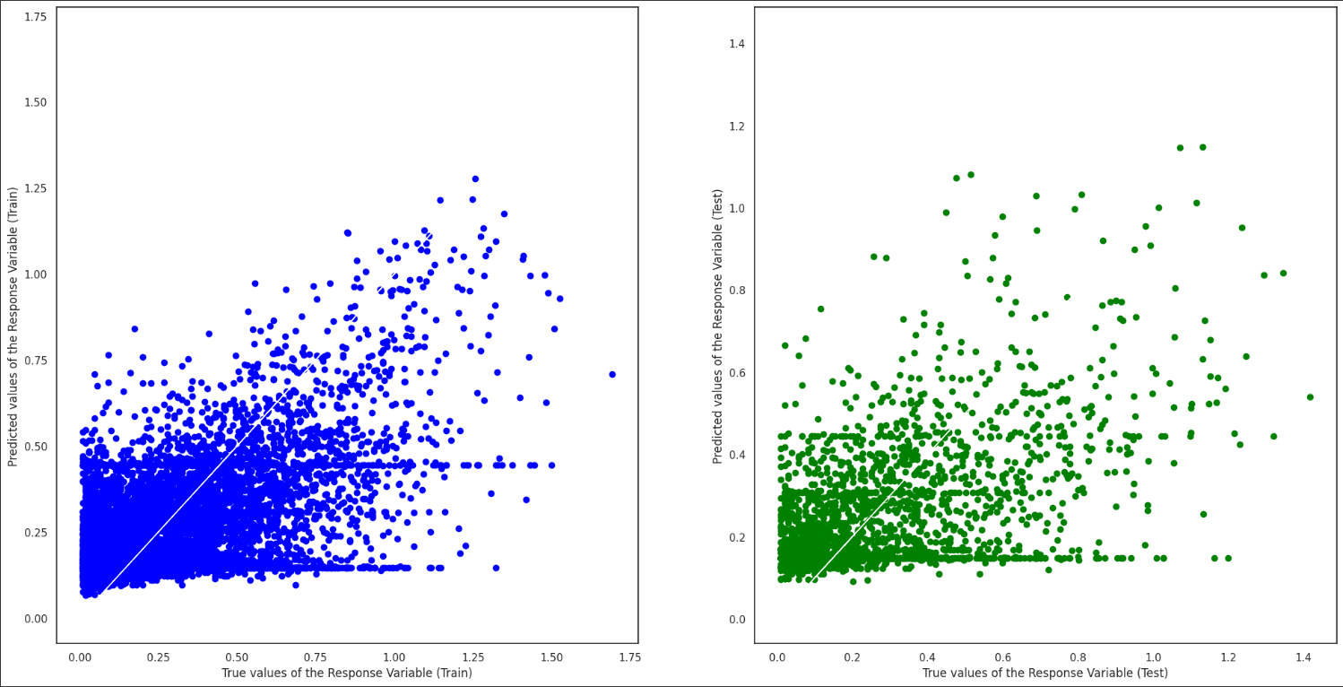
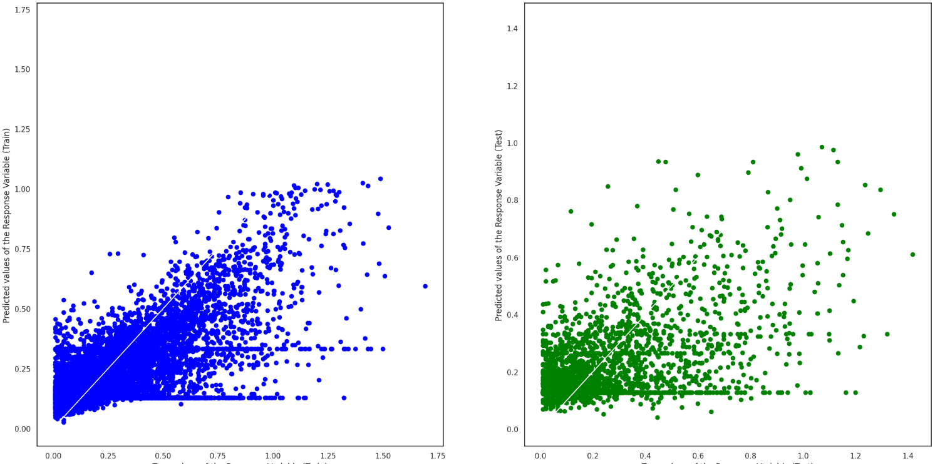
Conclusion of best hyperparameters
Before tuning
After Tuning
Notes:
These are the results before and after tuning of the model, we can see that there is a slight improvement of MAE in the model and this looks like hyperparameter tuning did not really improve the model.

Slide 32
Conclusion of project
Gradient Boosting Regression helped solve our main problem
Encountered into some issues
Critic_Score is the most important variable
Notes:
In conclusion, The gradient boosting Model did help solve our problem statement, but however we have encountered some issues such as Gradient Boosting having many parameters which made tuning of the hyperparameter a pain. We have also gathered that Critic_Score is one of the most important variable when it comes to the success of a video game

